Slide 1
Welcome!
Data Science for the Public Good
Stephanie Shipp
DSPg 2022 Introduction
31 May 2022

Slide 2


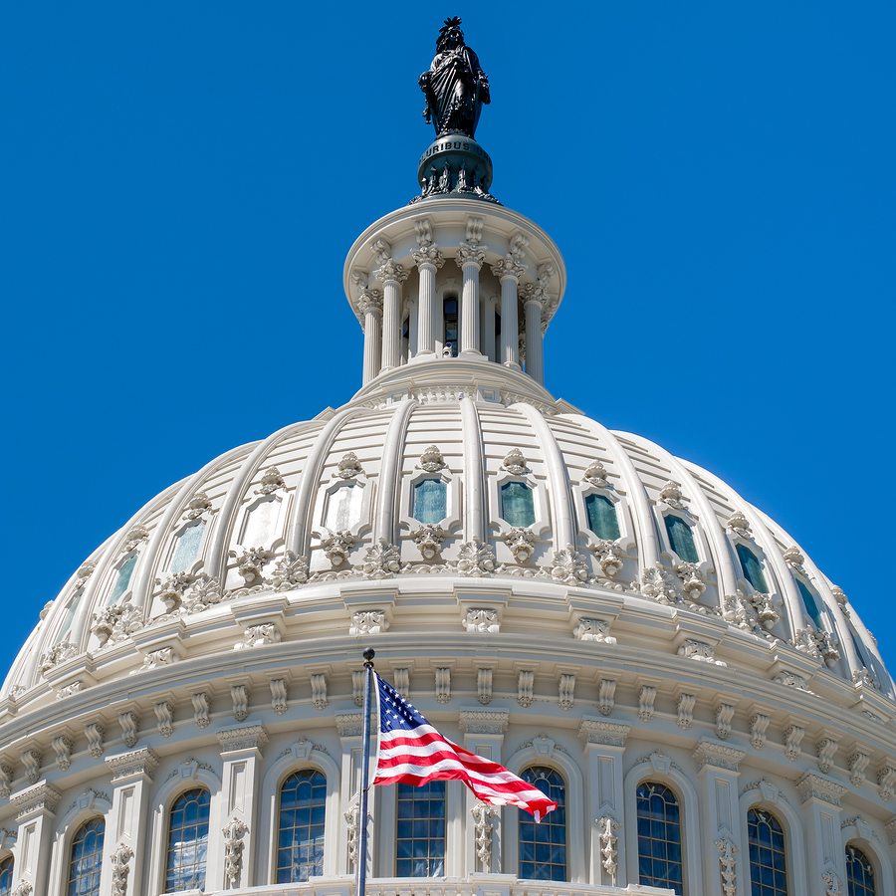
Biocomplexity Institute
Team science exploring the behavior of massively interacting living systems to develop practical solutions to real-world problems.
Mathematical Biocomplexity
Network Systems Science
and Advanced Computing
Social and Decision Analytics
Notes:
BII - From molecules to policy!
SDAD is an intentional collection of statistical sciences and social and behavioral sciences with a common interest in studying the social condition at scale.
Welcome to the Biocomplexity Institute and the Social and Decision Analytics Division.
how to frame it, how to teach it, how to make it integral to your work – how can data inform your decisions?
Unique Institute in the University of Virginia.
We have the same stature as other UVA schools with reporting lines directly to the Provost.
The range of our research is very exciting
The range is from mathematical biocomplexity around theoretical mathematics focusing on genomics and sequencing.
We then move from the molecular level and scale to other behavior scales and massive simulations around people, and movements of people throughout time and place – this is the work done by the NSSAC division. They created the COVID modeling that supported the governors of Virginia and New York and many others who used the data to make predictions about their workplace, industry, or customers.
As we scale to evidenced based policy, you start to engage with the research of our division. Because of this rich strong policy focus, we are located in Northern Virginia to be in the policy capital of the world and we are keeping our eyes wide open on how to bring our work to bear on important public policy. That is us!

Slide 3
What is data science?
Data science is learning from data in the context problems
Without a problem, there is no data science
Problem solutions require carefully framed questions
Notes:
Start by defining data science and the ethics issues associated with data science.
So what is data science?
We view data science as a science that starts at the point of translation bc it is in the context of real problems.
If we don’t have a problem, we don’t have data science.
ML, NLP, even statistical analysis are all tools we use in data science – they are not data science per se.
What is important is that if we focus on problems, problem solutions require carefully framed questions. That plays a roll when doing data science and what we call data acumen.
Bringing data to bear on real problems is the genius of this new transdisciplinary field we call data science.
There is an important consequence

Slide 4

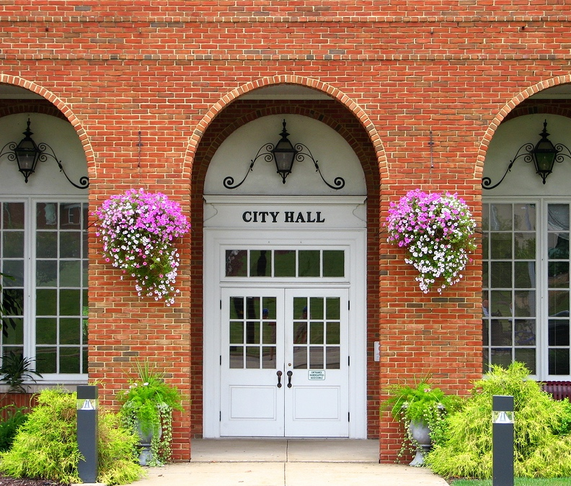
Our data science partners
Industry
Federal Statistical Agencies
DOD: U.S. Army
Local Government
Notes:
Creating the Science of Data by working very applied problems across all sectors. Industry, DOD, especially the US Army, Federal Statistical Agencies and local govts.
NOTE – Industry include P&G, MITRE, GT

Slide 5

Data science is a team sport
Notes:
Important to remember that Data Science is a team sport. This is our team when we first joined UVA. We have grown since then.
This let’s us take on hard problems the transcend any one person or discipline – we are a mix of social scientists, statisticians, systems engineerts
This is changing the nature of organizations and how organizations that will use data science need to be managed – this leads us into the context of our session today – Data Literacy or Acumen, as we prefer to express it.

Slide 6

Data acumen
Data acumen is the ability to make good judgements about the use of data to support problem solutions.
Data Acumen In Action. (2021). Notices of the American Mathematical Society, 68(9):1468-1477
Notes:
Data informed decision making.
There is a long history of introducing data literacy to the general public.
The desire to apply data to solving societal problems is not new, though modern technology has brought new challenges.
As data have become more available and preva-lent in the general public, many terms have evolved to de-scribe a broad understanding of the role for data, analyses, and statistics in a modern democratic society. One popu-lar term, data literacy, moved from a focus on the ability to collect, store, retrieve, and view data to a concern about the ability to comprehend and apply data in the required context. Additional terms have come into use including quantitative literacy, statistical literacy, statistical thinking, and numeracy [Sch03, PR11].
Historically, these literacy terms have focused on the ability to do and understand statistics, with an empha-sis on basic quantitative reasoning. In the 1990s to early 2000s, data literacy (and related terms) meant knowledge and understanding sufficient to lead, use, and inform decision-making. These early insights foreshadow data acumen, noting that quantitative literacy “empowers peo-ple by giving them tools to think for themselves, to ask intelligent questions of experts, and to confront authority confidently” [Ste99, p. 2] and that “statistical thinking is essential for anyone who wants to be an informed citizen, intelligent consumer, or skilled worker” [Sch03, p. 146]. We subsume all of these terms under the rubric of data science. As data science took hold over the next decades,

Slide 7
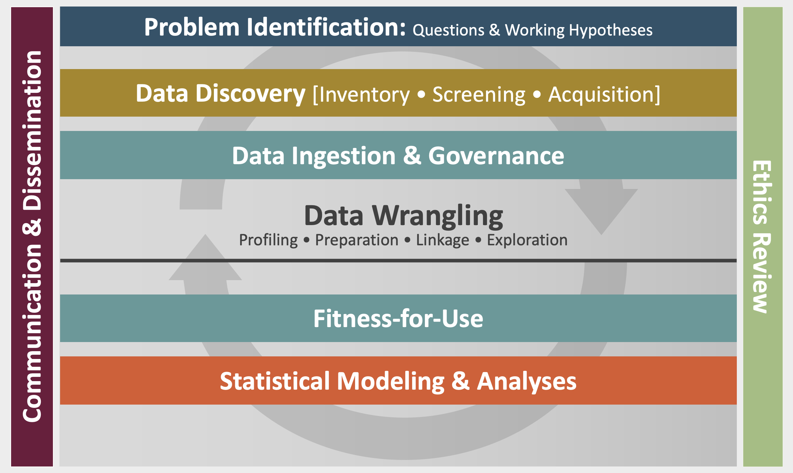
Data Science Framework
S.A. Keller, S.S. Shipp, A. D., Schroeder, & G. Korkmaz, (2020). Doing Data Science: A Framework and Case Study. Harvard Data Science Review, 2(1).
Notes:
Here we can recap and highlight that they have walked through the DS Framework at each step – this reinforces the last on slide 19 – know what part of the DS process is being discussed or presented.
Models are the basis for analytics
Could be a simple summary of the data as in a tabulation or correlation coefficient or a sophisticated theoretical model grounded in physical laws
Statistical models are at the heart of all analytics
Statistical models integrate observations and mathematical models, producing an integrated approach for linking model to reality
We have been walking through a DS process and here is the process
If I am the Decisionmaker and talk to leading the DS lead. Which stage of the DS? Are you talking about finding data? Fitness for use? Is this a Q of bias? Already walked thru process
Communication & Dissemination – throughout
Ethics

Slide 8
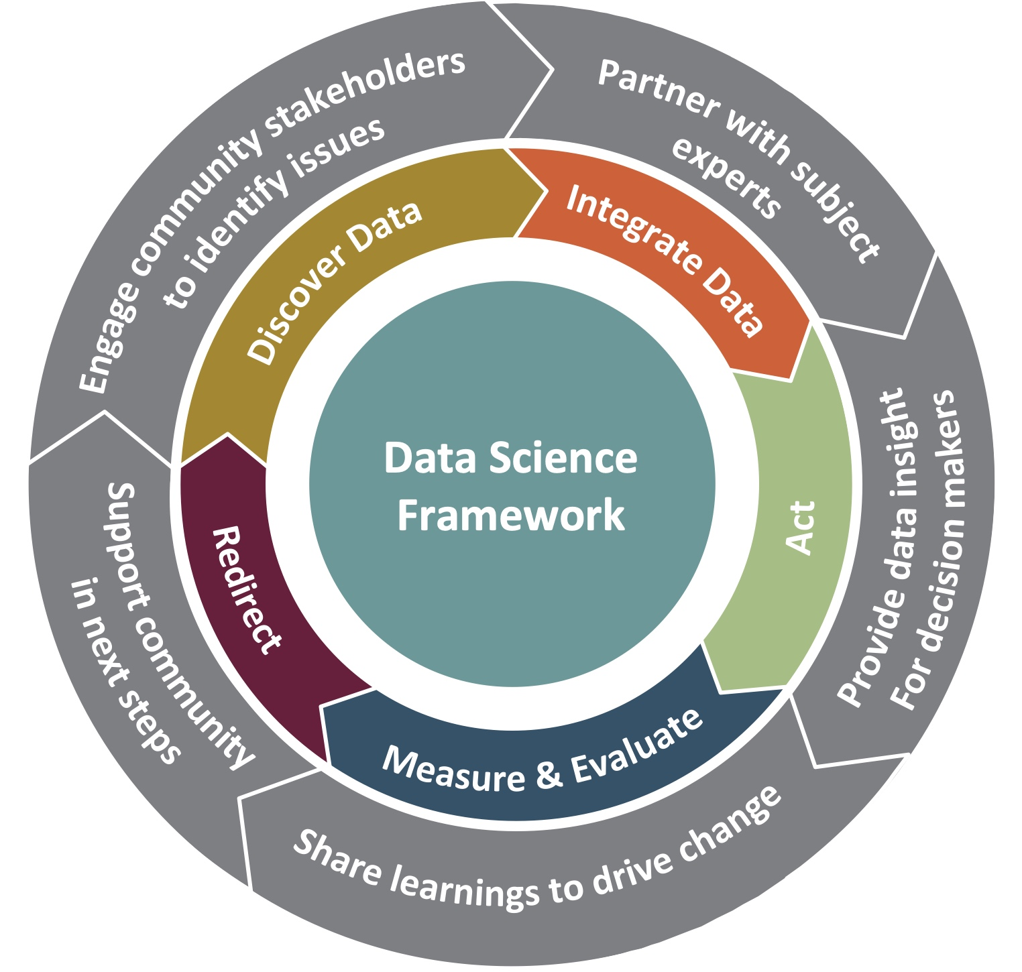
Building data acumen together
Community Learning Through Data Driven Discovery (CLD3)
CLD3 goes beyond traditional organizing aspects of collective action programs and supports communities in building capacity for data-informed decision making.
Outer wheel: continuous interaction and communication across stakeholders
Middle wheel: data-driven learning process
Frontier: between the outer and middle wheels is active collaboration between all partners
Inner circle: rigorous research framework to guide the data science
S. Keller, V. Lancaster, S. Shipp, 2017. Building Capacity for Data Driven Governance - Creating a New Foundation for Democracy, Statistics and Public Policy, 4:1-11.

Slide 9
Data acumen
Data acumen is the ability to make good judgements about the use of data to support problem solutions
Use of data — what are data?
Support problem solutions — how do you trust and use the results for data-informed decisions?
Notes:
Data informed decision making

Slide 10
Levels of data acumen
Data scientists trained in statistics, computer science, quantitative social sciences, applied math
Subject matter experts trained in a specific field, e.g., public health, engineering, or political science, who also have a range of training in data analytics
Consumers of the data science applications
Which are you?
Notes:
Levels of data acumen – ask the audience to gain a sense of what level they are a to gain a sense of the mix of skills.

Slide 11
Data acumen: how to use data to inform decisions?
What is the problem? What are the questions?
What type(s) of decision needs to be made?
What data are available? Why should I trust the data?
What type of analyses are needed to inform the decision?
What are the ethical considerations?
What part of the data science process are we discussing?
Notes:
Across all levels, applying data acumen involves asking a series of questions about the situation and process. These questions include:What is the problem? (question refinement)
What type of decision needs to be made? (strategic, anticipatory, tactical)
What data are available? Why should I trust the data? (data discovery)
What type of analyses are needed to inform the decision? (descriptive/exploratory, explanatory, predictive, modeling & simulation, prescriptive)
What are the ethical considerations? (integrated into all parts of the process)
What part of the data science process is being discussed with me? (clear communication and dissemination throughout the entire data science process)

Slide 12



Example: Arlington, Virginia
Population: 238,643
Size: 26 sq. mi.
Unemployment: 2.1%
Race: 61% white*
* White alone, not Hispanic or Latino
S. Keller, S. Shipp, G. Korkmaz, E. Molfino, J. Goldstein, V. Lancaster, B. Pires, D. Higdon, D. Chen, A. Schroeder, 2018. Harnessing the power of data to support community‐based research. WIREs Comp Stat 2018. doi: 10.1002/wics.1426
Notes:
Set this us as an example to use to highlight the next slides.
Say a couple of words on

Slide 13
Data acumen: how to use data to inform decisions?
What is the problem? What are the questions?
What type(s) of decision needs to be made?
What data are available? Why should I trust the data?
What type of analyses are needed to inform the decision?
What are the ethical considerations?
What part of the data science process are we discussing?
Notes:
What is the problem? (question refinement)
What type of decision needs to be made? (strategic, anticipatory, tactical)
What data are available? Why should I trust the data? (data discovery)
What type of analyses are needed to inform the decision? (descriptive/exploratory, explanatory, predictive, modeling & simulation, prescriptive)
What are the ethical considerations? (integrated into all parts of the process)
What part of the data science process is being discussed with me? (clear communication and dissemination throughout the entire data science process)

Slide 14
Arlington, Virginia
Population: 238,643
Size: 26 sq. mi.
Unemployment: 2.1%
Race: 61% white*
* White alone, not Hispanic or Latino
Problem: Develop data-informed situational awareness with the goal to improve quality of life and services while accelerating county’s efficiency and resiliency
1st Question: Fire Chief wanted to know if we could link Fire/EMS data end-to-end to recreate incidents to understand resource utilization
Notes:
The Fire Chief in Arlington, Virginia, wanted to gain better situational awareness on how well the Fire/Emergency Management Service (EMS) was serving the residents, particularly the vulnerable populations. The county had silos of fire/EMS operational systems where information flowed during the course of an incident to manage the deployment of resources and respond to state and national reporting as shown in Figure 1. The systems were not designed with unique identifiers to connect the information across the systems for the incidents.
To turn this information into data required statistically linking across these systems and recreating the incidents over time and geographic locations. To make these data useful for addressing issues associated with vulnerable populations, more information was needed. We linked the data by matching on time, date, and location of incident and integrated American Community Survey so-cioeconomic data to describe Arlington neighborhoods and social media data to provide context (see Figure 1)[. By linking these data, the Fire Chief had a corpus of data to answer these questions as well as oth-ers about types of incidents by season, when special events occurred, and by neighborhood.

Slide 15
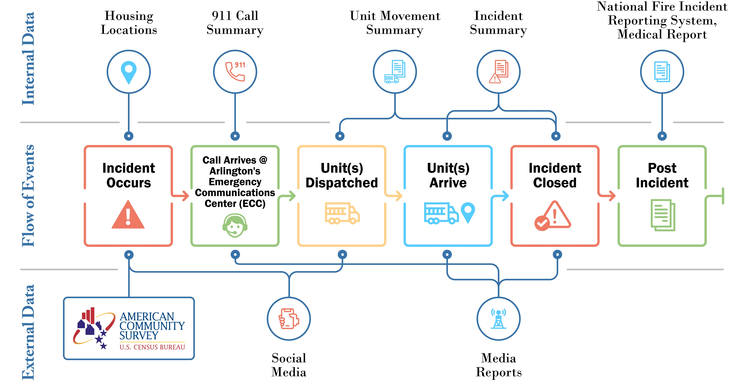
Arlington Fire/EMS data discovery
Notes:
Mash up their systems
. As shown in Figure 1, and collaborating with the Fire Chief and his staff, we identified a corpus of information that could be used to strategically support future force and resource development and at the same time better anticipate to plan the weekly allocation of resources across the county. Once linked, the data pro-vided valuable insights for unit utilization as shown in Fig-ure 2. The Fire Chief’s focus was to ensure that the limited number of medical units were in the right place at the right time [KLS17].

Slide 16
Data acumen: how to use data to inform decisions?
What is the problem? What are the questions?
What type(s) of decision needs to be made?
What data are available? Why should I trust the data?
What type of analyses are needed to inform the decision?
What are the ethical considerations?
What part of the data science process are we discussing?
Notes:
What is the problem? (question refinement)
What type of decision needs to be made? (strategic, anticipatory, tactical)
What data are available? Why should I trust the data? (data discovery)
What type of analyses are needed to inform the decision? (descriptive/exploratory, explanatory, predictive, modeling & simulation, prescriptive)
What are the ethical considerations? (integrated into all parts of the process)
What part of the data science process is being discussed with me? (clear communication and dissemination throughout the entire data science process)

Slide 17
Types of decisions
Strategic decision-making — inform and enrich understanding of problems and issues to plan for future operations
Anticipatory decision-making — detect, identify, and warn of emerging issues and discontinuities
Current (tactical) decision-making — support ongoing actions and operations
Adapted from https://www.dni.gov/index.php/what-we-do/what-is-intelligence
Notes:
Time dimension
Strategic (policy orientation versus case study) – bigger picture, future orientation – combine with anticipatory
Tactical – current implementation, e.g. smoke alarm started as a strategic decision and using data analysis implementation through tactical decision-making.
ALSO – Strategic will go with the desire for Prescriptive analytics whereas Anticipatory goes with M&S – ganing experience about possible futures through M&S
Strategic decisionmaking — inform and enrich understanding of problems and issues to plan for future
Anticipatory decision-making—detect, identify, and warn of emerging issues and discontinuities
Current(tactical) decision-making—support ongoing actions and operations
Strategic decision-making informs and enriches understanding of problems and issues to plan for future operations. It involves developing an un-\derstanding of the context, knowledge, and in-telligence to support planning. The steps to develop a strategic plan include identifying future ca-pabilities, activities, and expectations for change and evaluating it against the current capabilities to identity gaps.
Anticipatory decision-making is used to detect, identify, and plan for emerging issues and dis-continuities. It involves collecting and analyzing information to identify emerging trends, chang-ing conditions, and unexpected consequences of these trends and changes. The process is to ques-tion assumptions and advance new perspectives from many disciplines, as well as identify new op-portunities and risks.
•
Tactical decision-making supports ongoing acions and current operations.

Slide 18
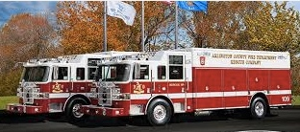
Strategic and anticipatory decision making in Arlington
Question: Fire Chief wanted to know if we could link Fire/EMS data end-to-end to recreate incidents to understand resource utilization
Decisions: Anticipatory and strategic — corpus of data (mash up 911 incidents with local socio-economic data) to support force and resource development
Notes:
(Decision-making for Arlington County, Vir-ginia, Fire Department). Continuing with the above exam-ple, the Fire Chief in Arlington, Virginia, also wanted to use Fire/Emergency Management Service (EMS) data for both strategic and anticipatory decision-making concern-ing resource utilization

Slide 19
Data acumen: how to use data to inform decisions?
What is the problem? What are the questions?
What type(s) of decision needs to be made?
What data are available? Why should I trust the data?
What type of analyses are needed to inform the decision?
What are the ethical considerations?
What part of the data science process are we discussing?
Notes:
What is the problem? (question refinement)
What type of decision needs to be made? (strategic, anticipatory, tactical)
What data are available? Why should I trust the data? (data discovery)
What type of analyses are needed to inform the decision? (descriptive/exploratory, explanatory, predictive, modeling & simulation, prescriptive)
What are the ethical considerations? (integrated into all parts of the process)
What part of the data science process is being discussed with me? (clear communication and dissemination throughout the entire data science process)

Slide 20
Data Acumen: What are data?
Any fact assumed to be a matter of direct observation
Questions are needed to inform direct observation
Measurement is needed to create facts from observation
Notes:
Observing had been around this the dawn of time, but the word data was coined around 1640
What do we need to make a direct observation? Problems framed as Questions
How do you create a fact from observation? Measurement – in data science this shows up in many forms – and we will talk about that.

Slide 21
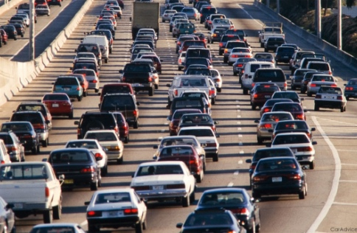

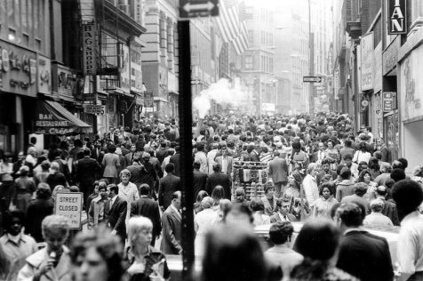
What can we observe? Harnessing the all data revolution
Infrastructure
Environment
People
Built environment
Condition
Operations
Resilience
Sustainability
Climate
Pollution
Noise
Flora/ Fauna
Relationships
Location
Economic Condition
Communication
Health
Notes:
Data Availability – what is available?
A new lens for social observing

Slide 22










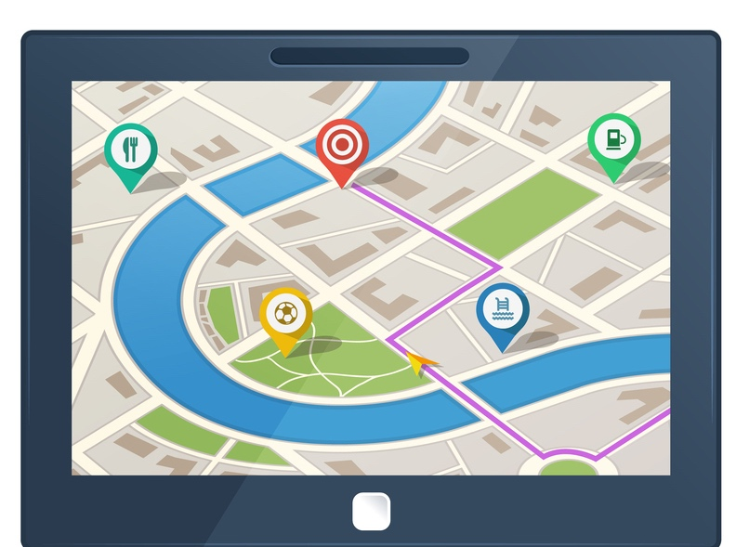

Measurement: data repurposing
How data are born
Designed Data
Administrative Data
Opportunity Data
Procedural Data
Opportunity
Data
Procedural Data
Notes:
Mash up their systems

Slide 23
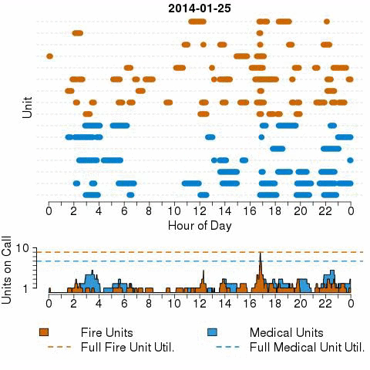
Measurement: 911 data linkages
Notes:
Run out of units every day at 4:00, where are they? If the lower graph hits the dotted line, units are not available. Are the colors correct?
Minutes that units are on a call – note that the blue bars on the right reflect medical units – they are out much longer than fire units. Black dots reflect outliners. Some black dots below the line are false alarms.

Slide 24
Data acumen: how to use data to inform decisions?
What is the problem? What are the questions?
What type(s) of decision needs to be made?
What data are available? Why should I trust the data?
What type of analyses are needed to inform the decision?
What are the ethical considerations?
What part of the data science process are we discussing?
Notes:
What is the problem? (question refinement)
What type of decision needs to be made? (strategic, anticipatory, tactical)
What data are available? Why should I trust the data? (data discovery)
What type of analyses are needed to inform the decision? (descriptive/exploratory, explanatory, predictive, modeling & simulation, prescriptive)
What are the ethical considerations? (integrated into all parts of the process)
What part of the data science process is being discussed with me? (clear communication and dissemination throughout the entire data science process)

Slide 25
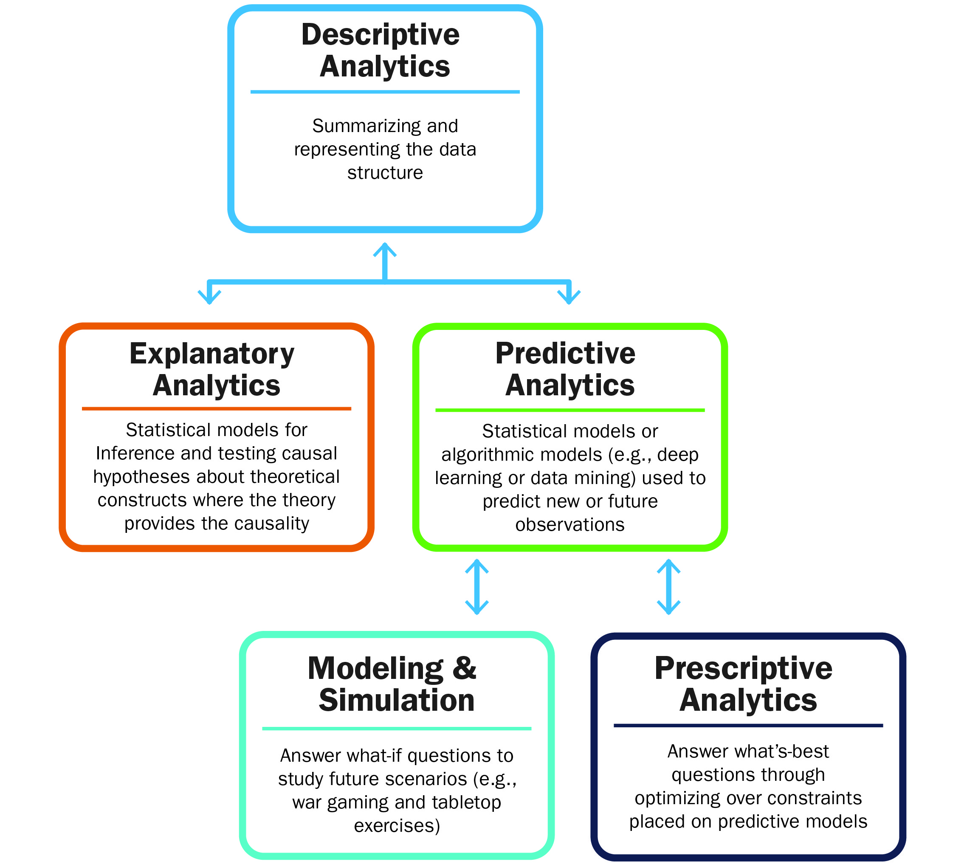
Types of Analyses
Notes:
M&S and Prescriptive should both be called out . This will resonate with the DOD audiences and we can tie it back to the types of decisions --- strategic for prescriptive, if you can get there, and M&S for anticipatory.

Slide 26
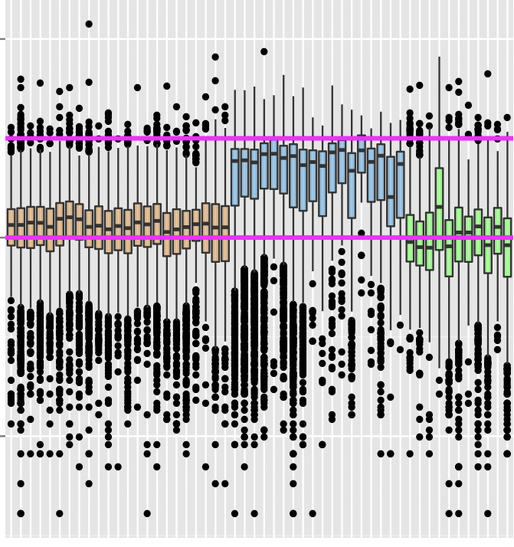
Descriptive: early data insights
Minutes on Call
1,000
10
.1
Fire Units Medical Units Other
Notes:
Repurposing of data and measurement- link the data across time line. SES does not come into play yet. By applying some good explanatory modelsing, can draw inferences.
Run out of units every day at 4:00, where are they? If the lower graph hits the dotted line, units are not available. Are the colors correct?
Minutes that units are on a call – note that the blue bars on the right reflect medical units – they are out much longer than fire units. Black dots reflect outliners. Some black dots below the line are false alarms.
Time on call. The chart illustrates the linked data from Figure 1 for the distributions of minutes on call (in log base 10 scale) for ﬁre (gold), medical (blue), and other (green). Medical units are out longer on call and require increased anticipatory planning to ensure they are located where needed.

Slide 27
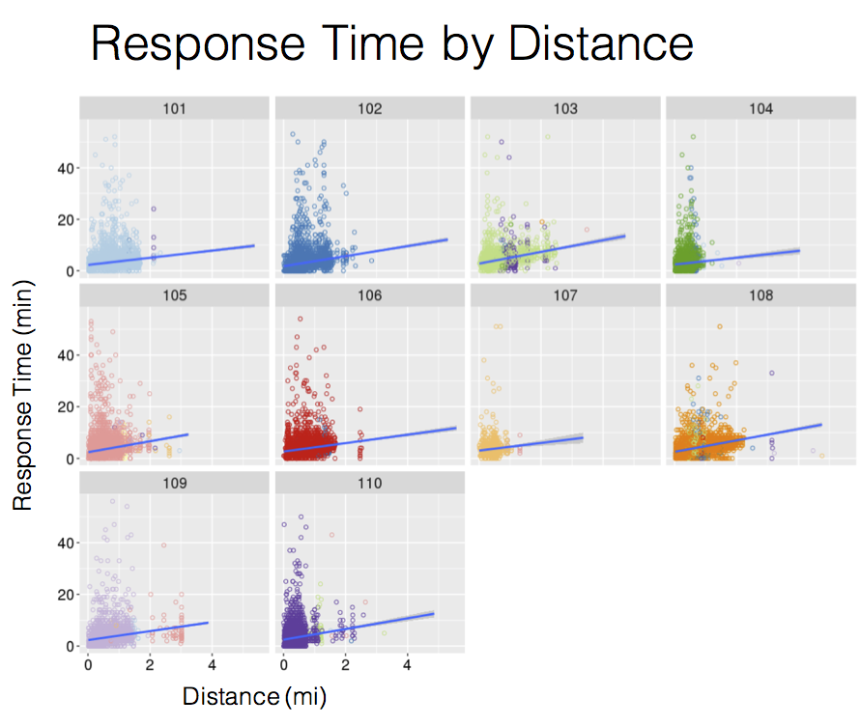
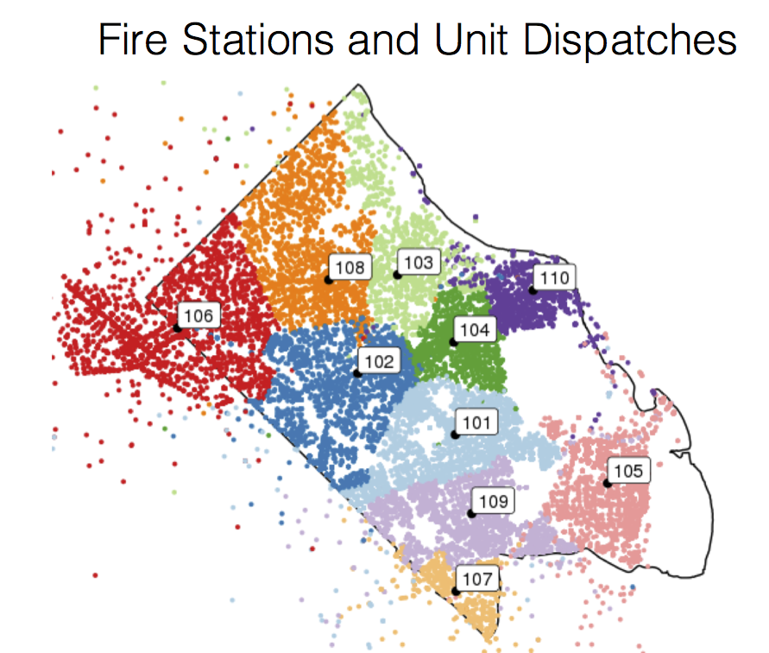
Descriptive: seconds matter
Notes:
These all look the same!!
We fit a Bayesian spatial regression generalized linear model controlling for apparatus type and station. Here I will show the travel time (versus turnout + travel) component.
National policy wants first units there within 4 minutes and all units within 8.
Fire Engine 9,139
Fire Truck 4,009
Rescue Unit 2,219
ALS Unit 2,008
Chief Officer Car

Slide 28
Explanatory: disentangle results
Bayesian spatial regression generalized linear model controlling for apparatus type and station
Notes:
A descriptive analysis did not was not statistically sig-
nicant dierences across stations. This is be-
cause when the data were pooled across types of
incidents the variability in the data masked poten-
tial dierences due to the apparatus types that were
deployed.
An explanatory analysis was developed
by creating a spatial regression model patterned af-
ter [GH18] to control for apparatus type and station.
[AGK+19]. It was this statistical controlling for ap-
paratus type and station that surfaced signicant dif-
ferences in response times across several stations (see
Figure 4). The Fire Chief used this information to
inform his strategic plans for locations of new re sta-
tions and tactical planning about changes in current
procedures to decrease time to incidents
Credible intervals based on Bayesian model controlling for features such as units, stations, apparatus type, etc. – station difference. Making the upper limit of 8 but not the 4 min goal.
Also have looked at difference in apparatus type and turn out time ….

Slide 29
Data acumen: how to use data to inform decisions?
What is the problem? What are the questions?
What type(s) of decision needs to be made?
What data are available? Why should I trust the data?
What type of analyses are needed to inform the decision?
What are the ethical considerations?
What part of the data science process are we discussing?
Notes:
What is the problem? (question refinement)
What type of decision needs to be made? (strategic, anticipatory, tactical)
What data are available? Why should I trust the data? (data discovery)
What type of analyses are needed to inform the decision? (descriptive/exploratory, explanatory, predictive, modeling & simulation, prescriptive)
What are the ethical considerations? (integrated into all parts of the process)
What part of the data science process is being discussed with me? (clear communication and dissemination throughout the entire data science process)

Slide 30
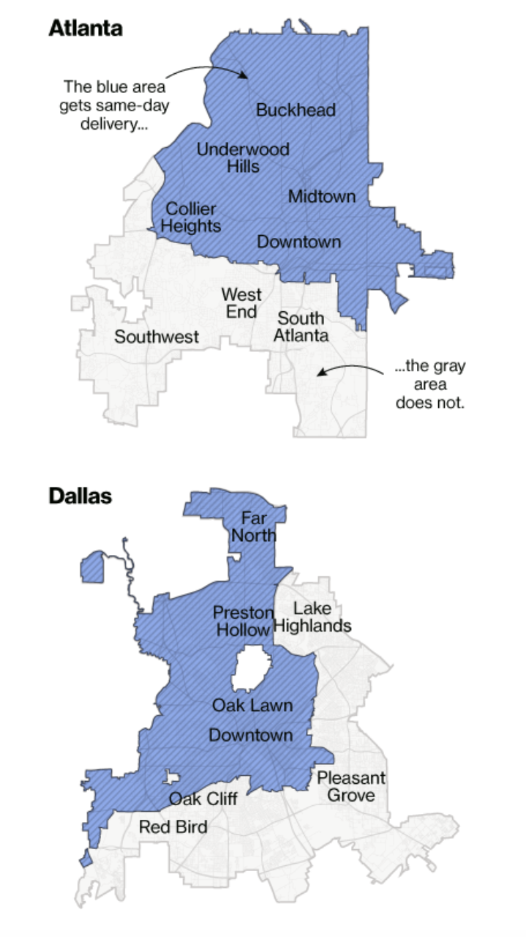
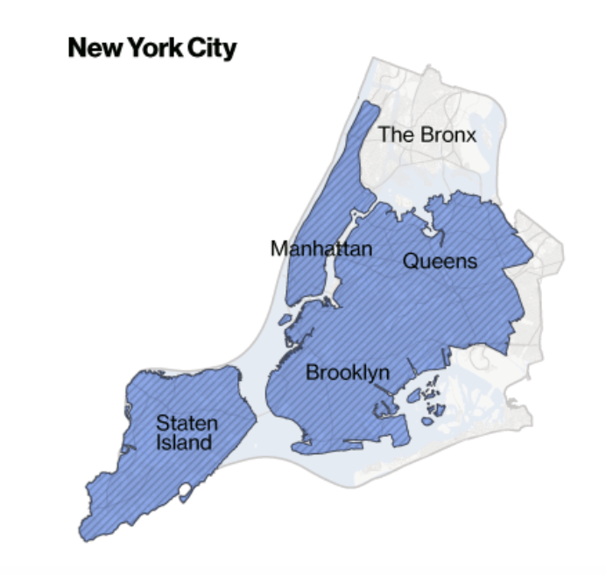


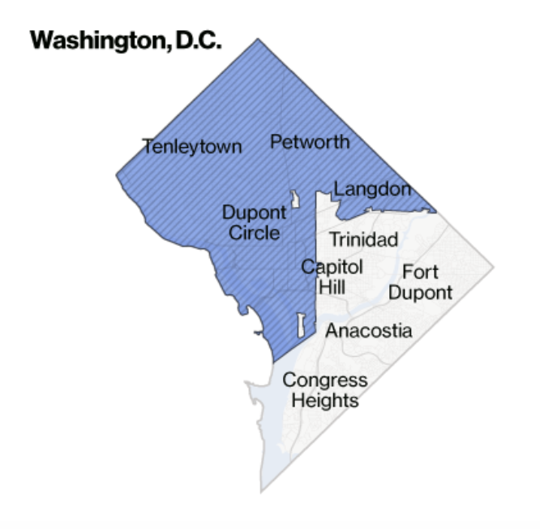
Why ethics? A cautionary note
April 21, 2016
Source: https://www.bloomberg.com/graphics/2016-amazon-same-day/
Notes:
The next slides are about how the data are born – trust the data We need to be sure to hit “measurement” I adjusted some titles need some on the ethical considerations. I pulled some in from your datapalooza talk. I thought those worked well.
A second challenge is addressing whether there is implicit bias in our research questions, data chosen, methods used, and our analysis and findings.
This Amazon Prime example provides a good example of this.
Amazon algorithmically determined which neighborhoods would get Prime Same Day delivery.
They did not consider race, yet the data mapped almost perfectly by race.
The blue areas are the ones that get same day delivery and white areas are primarily minority neighborhoods that were not planned for SAME DAY DELIVERTY.
So even though the algorithms did not use race, the data picked up the social biases, ….. and perhaps they should have used race.

Slide 31
The Belmont Report
The Belmont Principles provide the foundation for the Institutional Review Board (IRB) process and for a principles-based approach to ethics.
Respect for persons – honoring individual wishes
Beneficence – weighing risks and benefits of study
Justice – fair distribution of risks and benefits
Led to the Common Rule which governs U.S. Government research
Focus is on “research involving human subjects”
1979
Notes:
Let’s step back and review the history related to research and ethics.
The Belmont Commission was convened in the late 1970s after ethical failures by researchers became known.
The most famous example of one of these failures is the Tuskegee Syphilis Study conducted from 1932-1972 to observe the natural progression of untreated syphilis of poor African-American men.
None of the men were told that they had the disease, and none were treated with penicillin even after the antibiotic was proven to successfully treat syphilis.
The Belmont Commission issued 3 principles for the conduct of ethical research
These principles are
Respect for persons – treating people as autonomous and honoring their wishes
Beneficence – understanding the risks and benefits of the study and weighing the balance between (1) do no harm and (2) maximize possible benefits and minimize possible harms.
Justice – deciding if the risks and benefits of research are distributed fairly
The principles were codified into law and are now referred to at the Common Rule.
The Belmont Report provided the foundation for the Institutional Review Board’s principles and focus on ‘research involving human subjects.”

Slide 32
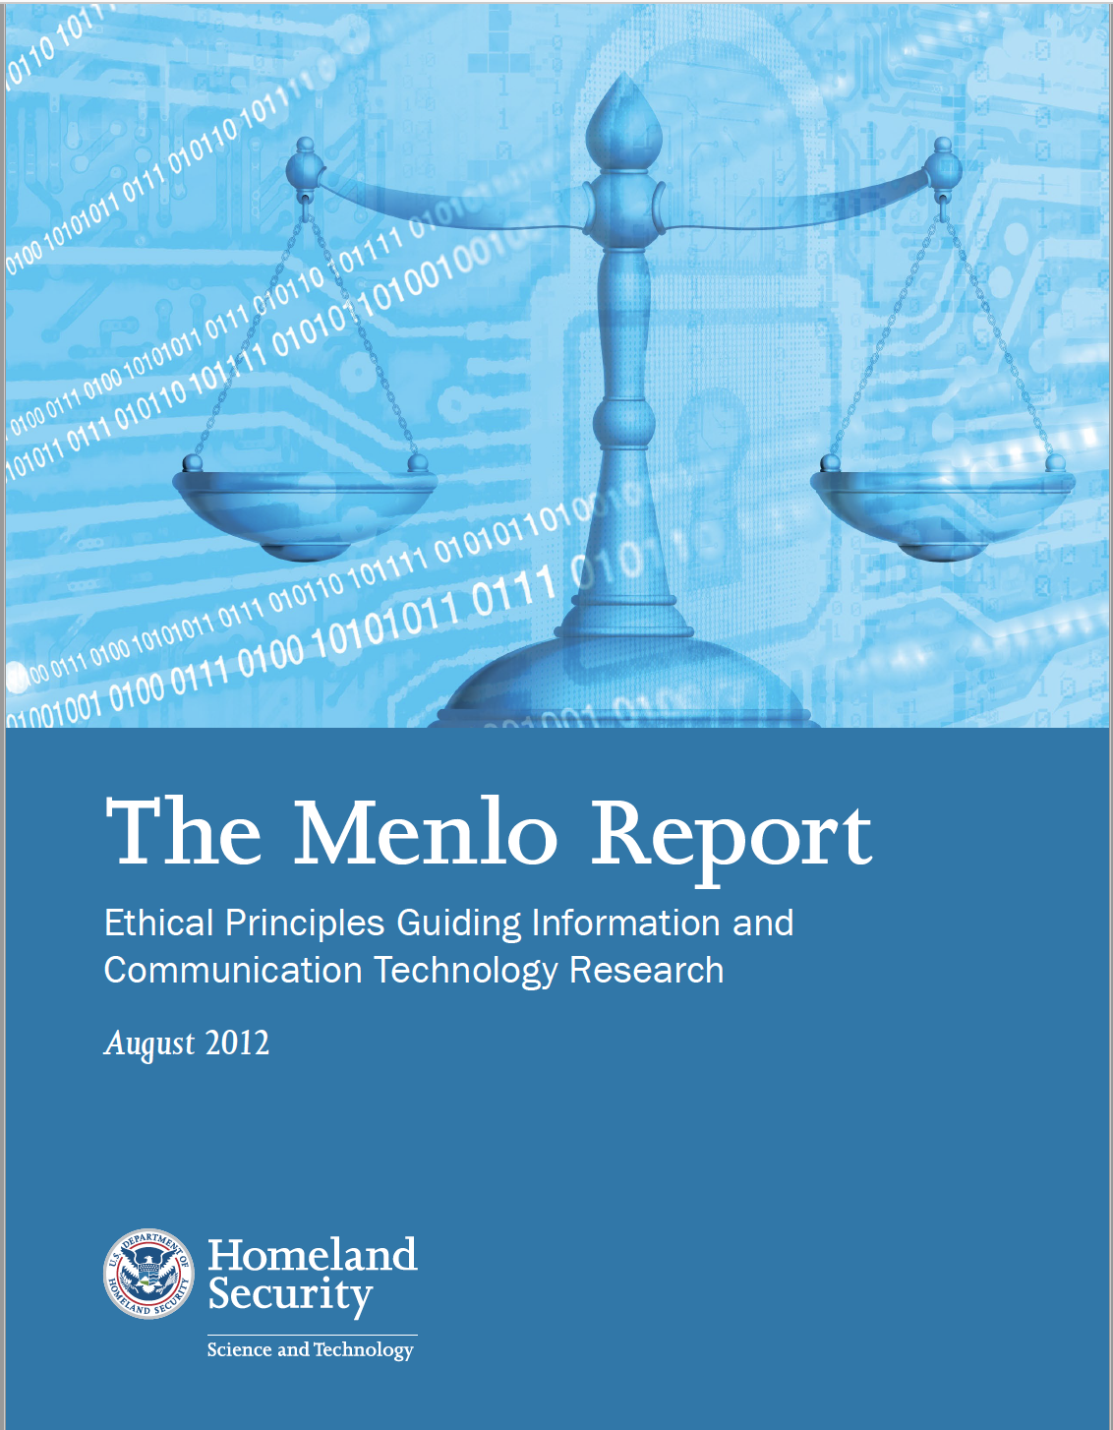
The Menlo Report
Department of Homeland Security commissioned a report to introduce Belmont principles in ICT (Information, Communication, Technology)
The Menlo Report extends the Belmont Principles to include Respect for Law and Public Interest
Focus is on “research with human-harming potential”
2012
Notes:
The Menlo report was commissioned by the Department of Homeland Security to bring the Belmont principles to the Information, Communication, and Technology or ICT community.
They also expanded the Belmont principles in two important ways:
They added a 4th principle - Respect for Law and Public Interest – extends principle of beneficence to include all relevant stakeholders
And they expanded the focus to include “research with human-harming potential,” not just a focus on “research on human subjects.”
This change is important in the digital age where the use of digital technologies and repurposing of data can expose people to risks.
We recommend that our projects should embrace the broader criteria set forth in the Menlo Report.
Data scientists can lead the way.

Slide 33
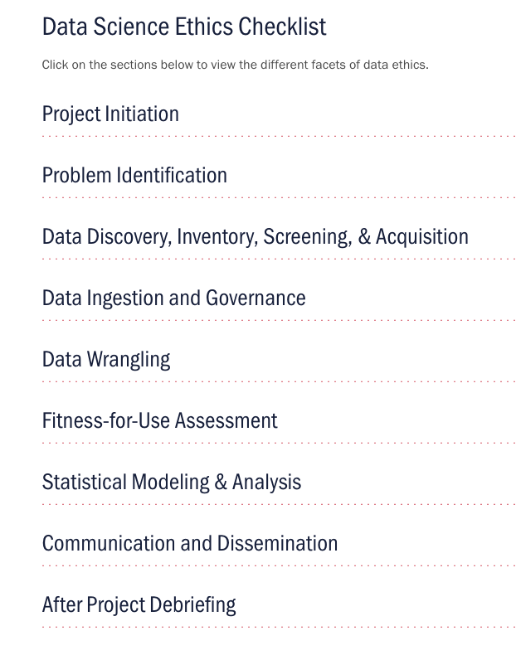
Data Science Ethics Checklist
Adapt criteria to ensure implementation of ethical principles into the project
Make discussion of ethics and implicit biases a continuous part of the project
Seek expert help when ethical questions at any stage cannot be answered by the research team
Incorporate ethical guidelines from relevant professional societies
Ensure documentation, transparency, ongoing discussion, and constructive criticism throughout the life of project
https://biocomplexity.virginia.edu/data-science-ethics
Notes:
Every research project should include a Data Science Ethics checklist at each phase of the project.
A key part of this checklist is the assessment of implicit biases throughout the project.
The ethical principles involved here require instilling ethics into all data science research practices that is reflected in project documentation, transparency, ongoing discussion, questioning, and constructive criticism.
A publicly-shared ethics checklist starts with the project planning phase that encompasses the entire project, not just completion of the Human Research Protections Program IRB process.
The IRB approval is necessary but not sufficient for addressing a researcher’s ethical responsibility in his/her research.
The checklist provides a mechanism to ensure that ethical principles be discussed throughout the project informally and formally at specific milestones.
Just having a checklist does not mean that this is easy. The checklist is a reminder that dialogue is needed at every stage of the research/.

Slide 34
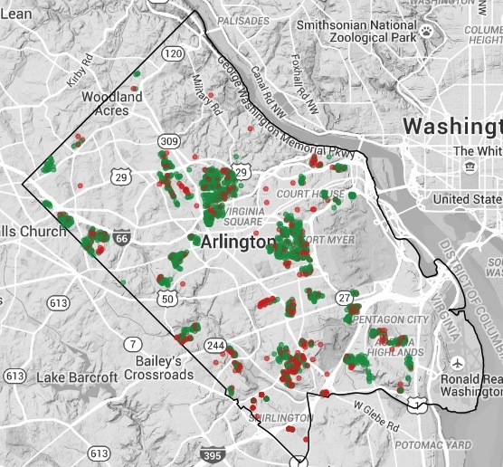
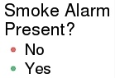
Citizen Safety: Operation Firesafe
Ethics matter
Predictive model: ensuring safety
Ensure at-risk citizens have smoke detectors.
Notes:
NEED TO BRING ETHICS LANGUAGE INTO THIS EXAMPLE
This example could be a good one to highlight ethics – this analysis draws attention to SES disadvantaged homes – is that fair. Also was the original data biased (see next comment) It is also a predictive model example. Also a good way to recap trust in data as there was not a designed sampling plan but we did extensive uncertainty quantification and validated with the new data
Mashed up the fire data with ACS and the AC housing stock – designed data + Admin data + opportunity data!!
Bayesian logistic regression model with conditionally autoregressive spatial effects
Using a Bayesian logistic regression model to estimate the probability that a housing unit has a smoke alarm.
The results show that the Fire Dept. should focus on the southwest (bottom left hand corner) of Arlington.
This is an example of an issue that required mapping multiple sources of different kinds of data to inform a topic.
The model estimates the probability that a housing unit has a smoke alarm.
We fit a Bayesian logistic regression model with conditionally autoregressive spatial effects.
Because of the spatial dependence included in the model, the predictions are made for each residential unit in the CoreLogic data source that are:
in census block groups that appeared in the original data or in a census block group neighboring those in the original data; and
with no missing covariate values and/or census block group information.
Predictions are made for 49,178 residential units.
House Level Predictors:
home value
home age
Block Group Level Predictors:
median income
% single family homes
% living alone
Metrics
• Precision: When the model suggests the home has a smoke alarm, what
percentage of these homes actually have it?
• Recall: What percentage of homes with alarms is the model catching?
When 𝑝" < 𝑡 for threshold 𝑡, the model predicts that household 𝑖 needs a smoke
alarm intervention
• We find the value of t that maximizes precision and recall
Models are trained using repeated holdout samples of 10%, 15% and 20%
of the observations
• For each holdout sample, the model is fit and predicted probabilities are assigned
to the holdout samples
2015 Operation FireSafe data used to estimate the performance of 2016 data
• Then both years were used to make final predictions for 2017
Predictions made at the household level and aggregated to Census block groups

Slide 35
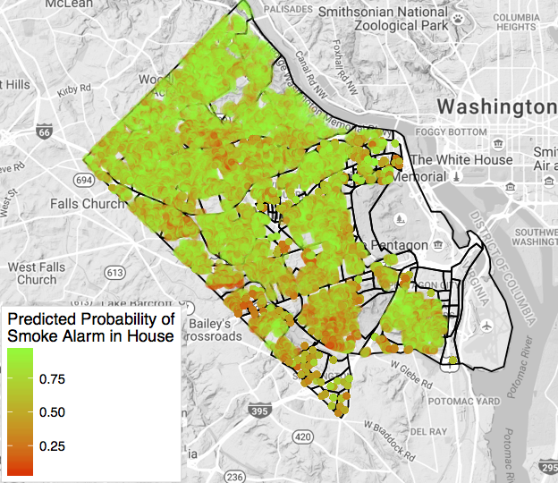
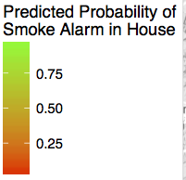
Tactical decisions and actions
Predictive probabilities of smoke alarms
Census Block Level Predictions
Housing Unit Level Predictions
Notes:
Bayesian logistic regression model with
conditionally autoregressive spatial effects
Using a Bayesian logistic regression model to estimate the probability that a housing unit has a smoke alarm.
The results show that the Fire Dept. should focus on the southwest (bottom left hand corner) of Arlington.
This is an example of an issue that required mapping multiple sources of different kinds of data to inform a topic.
The model estimates the probability that a housing unit has a smoke alarm.
We fit a Bayesian logistic regression model with conditionally autoregressive spatial effects.
Because of the spatial dependence included in the model, the predictions are made for each residential unit in the CoreLogic data source that are:
in census block groups that appeared in the original data or in a census block group neighboring those in the original data; and
with no missing covariate values and/or census block group information.
Predictions are made for 49,178 residential units.
House Level Predictors:
home value
home age
Block Group Level Predictors:
median income
% single family homes
% living alone
Predictive Performance:
Metrics
• Precision: When the model suggests the home has a smoke alarm, what
percentage of these homes actually have it?
• Recall: What percentage of homes with alarms is the model catching?
When 𝑝" < 𝑡 for threshold 𝑡, the model predicts that household 𝑖 needs a smoke
alarm intervention
• We find the value of t that maximizes precision and recall
Models are trained using repeated holdout samples of 10%, 15% and 20%
of the observations
• For each holdout sample, the model is fit and predicted probabilities are assigned
to the holdout samples
2015 Operation FireSafe data used to estimate the performance of 2016 data
• Then both years were used to make final predictions for 2017
Predictions made at the household level and aggregated to Census block groups

Slide 36
Data acumen: how to use data to inform decisions?
What is the problem? What are the questions?
What type(s) of decision needs to be made?
What data are available? Why should I trust the data?
What type of analyses are needed to inform the decision?
What are the ethical considerations?
What part of the data science process are we discussing?
Notes:
What is the problem? (question refinement)
What type of decision needs to be made? (strategic, anticipatory, tactical)
What data are available? Why should I trust the data? (data discovery)
What type of analyses are needed to inform the decision? (descriptive/exploratory, explanatory, predictive, modeling & simulation, prescriptive)
What are the ethical considerations? (integrated into all parts of the process)
What part of the data science process is being discussed with me? (clear communication and dissemination throughout the entire data science process)

Slide 37


Slide 38
Population: 328,013
Size: 2319 square miles
Unemployment rate: 2.8%
Race: 78% White*
*White alone, not Hispanic
Notes:
BACKGROUND
The Roanoke Valley Alleghany Region is a beautiful area of 5 counties and 3 cities in western Virginia. It has a population of about 300K+ and a low unemployment rate.
Unemployment hovers at about 2.5%
The population continues to fall. 313,289, https://censusreporter.org/profiles/31000US40220-roanoke-va-metro-area/
Population: 313,289+ Alleghany County (14734+ 328,013)
Size: 2319 square miles
Unemployment rate: 2.8%
Race: 78%
All other date are ACS 2020-5 https://censusreporter.org/profiles/31000US40220-roanoke-va-metro-area/
Unemployment rate FRED St Louis Feb, 2022
https://fred.stlouisfed.org/series/ROAN251URN

Slide 39
Data acumen: how to use data to inform decisions?
What is the problem? What are the questions?
What type(s) of decision needs to be made?
What data are available? Why should I trust the data?
What type of analyses are needed to inform the decision?
What are the ethical considerations?
What part of the data science process are we discussing?
Notes:
What is the problem? (question refinement)
What type of decision needs to be made? (strategic, anticipatory, tactical)
What data are available? Why should I trust the data? (data discovery)
What type of analyses are needed to inform the decision? (descriptive/exploratory, explanatory, predictive, modeling & simulation, prescriptive)
What are the ethical considerations? (integrated into all parts of the process)
What part of the data science process is being discussed with me? (clear communication and dissemination throughout the entire data science process)

Slide 42
Data acumen: how to use data to inform decisions?
What is the problem? What are the questions?
What type(s) of decision needs to be made?
What data are available? Why should I trust the data?
What type of analyses are needed to inform the decision?
What are the ethical considerations?
What part of the data science process are we discussing?
Notes:
What is the problem? (question refinement)
What type of decision needs to be made? (strategic, anticipatory, tactical)
What data are available? Why should I trust the data? (data discovery)
What type of analyses are needed to inform the decision? (descriptive/exploratory, explanatory, predictive, modeling & simulation, prescriptive)
What are the ethical considerations? (integrated into all parts of the process)
What part of the data science process is being discussed with me? (clear communication and dissemination throughout the entire data science process)

Slide 43
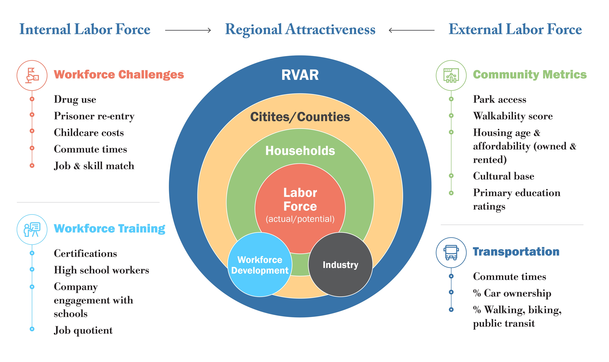

Slide 47
Data acumen: how to use data to inform decisions?
What is the problem? What are the questions?
What type(s) of decision needs to be made?
What data are available? Why should I trust the data?
What type of analyses are needed to inform the decision?
What are the ethical considerations?
What part of the data science process are we discussing?
Notes:
What is the problem? (question refinement)
What type of decision needs to be made? (strategic, anticipatory, tactical)
What data are available? Why should I trust the data? (data discovery)
What type of analyses are needed to inform the decision? (descriptive/exploratory, explanatory, predictive, modeling & simulation, prescriptive)
What are the ethical considerations? (integrated into all parts of the process)
What part of the data science process is being discussed with me? (clear communication and dissemination throughout the entire data science process)

Slide 50
Data acumen: how to use data to inform decisions?
What is the problem? What are the questions?
What type(s) of decision needs to be made?
What data are available? Why should I trust the data?
What type of analyses are needed to inform the decision?
What are the ethical considerations?
What part of the data science process are we discussing?
Notes:
What is the problem? (question refinement)
What type of decision needs to be made? (strategic, anticipatory, tactical)
What data are available? Why should I trust the data? (data discovery)
What type of analyses are needed to inform the decision? (descriptive/exploratory, explanatory, predictive, modeling & simulation, prescriptive)
What are the ethical considerations? (integrated into all parts of the process)
What part of the data science process is being discussed with me? (clear communication and dissemination throughout the entire data science process)

Slide 51

Ethics and Equity
Assessed each stage of the research for implicit biases
Many conversations with stakeholders
Sensitivity around drug rehabilitation and prisoner re-entry
Decided that issues were too important to ignore

Slide 53
Concluding thoughts
Data acumen is the ability to make good judgements about the use of data to support problem solutions
Data Science is learning from data in the context of problems
Type of decisions is critical for understanding value of analysis
Ethics and communication must be integrated throughout data science process
Data Science Framework enables creation of repeatable and measurable processes for the use & repurposing of all data sources

